Slide 1





Sexual health services for young people
In partnership with
Notes:
Do not delete

Slide 2


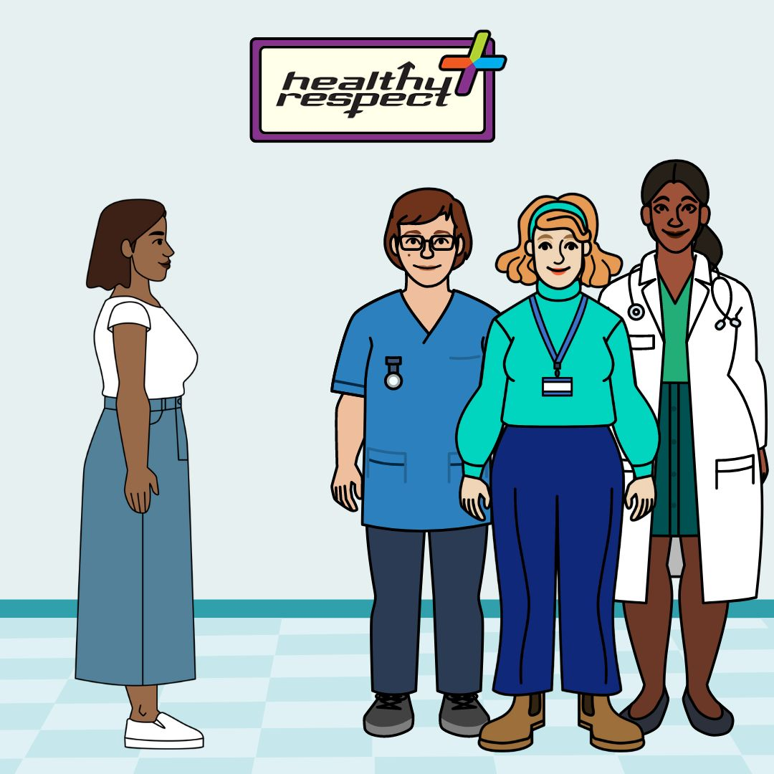

A sexual health service is a safe place:
for young people to talk about relationships and sexual health.
to talk to a trusted adult, such as a nurse, doctor or youth worker.
All identities welcome
Notes:
Do not delete

Slide 3
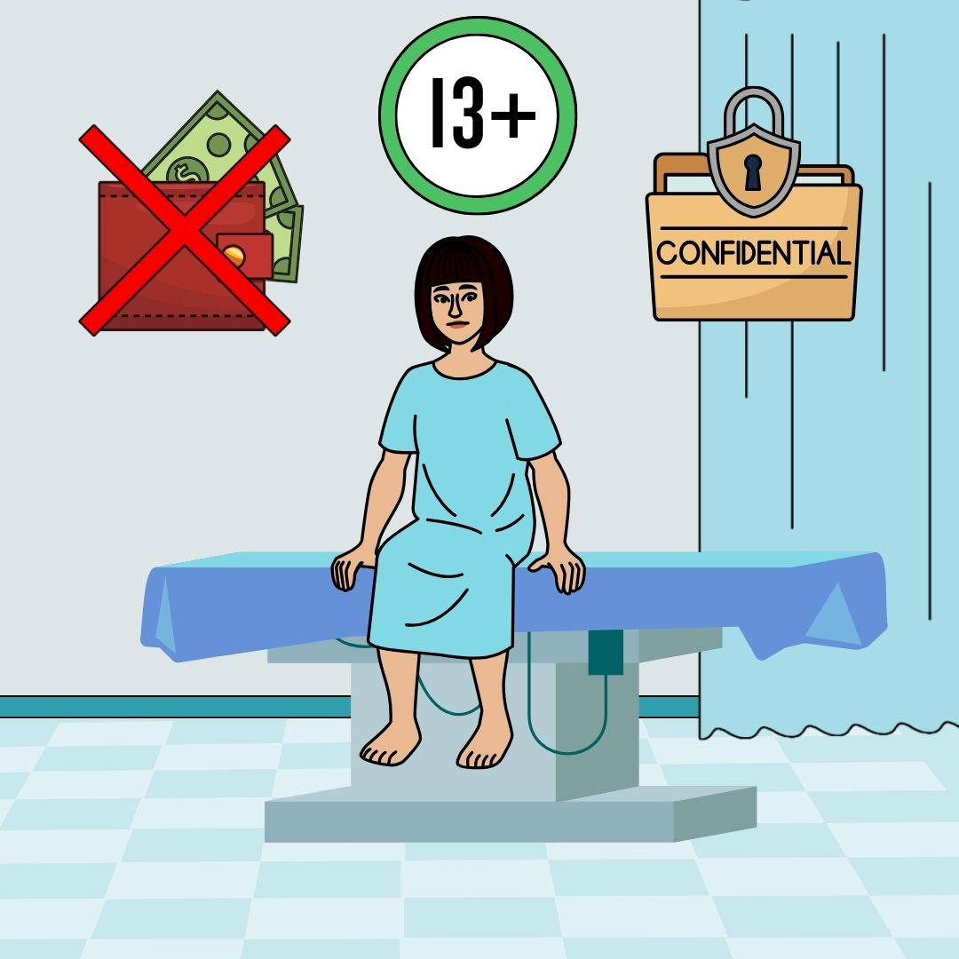
Young people aged 13 and older have the right to:
free, confidential sexual health help, advice and treatment.
Notes:
Do not delete

Slide 4
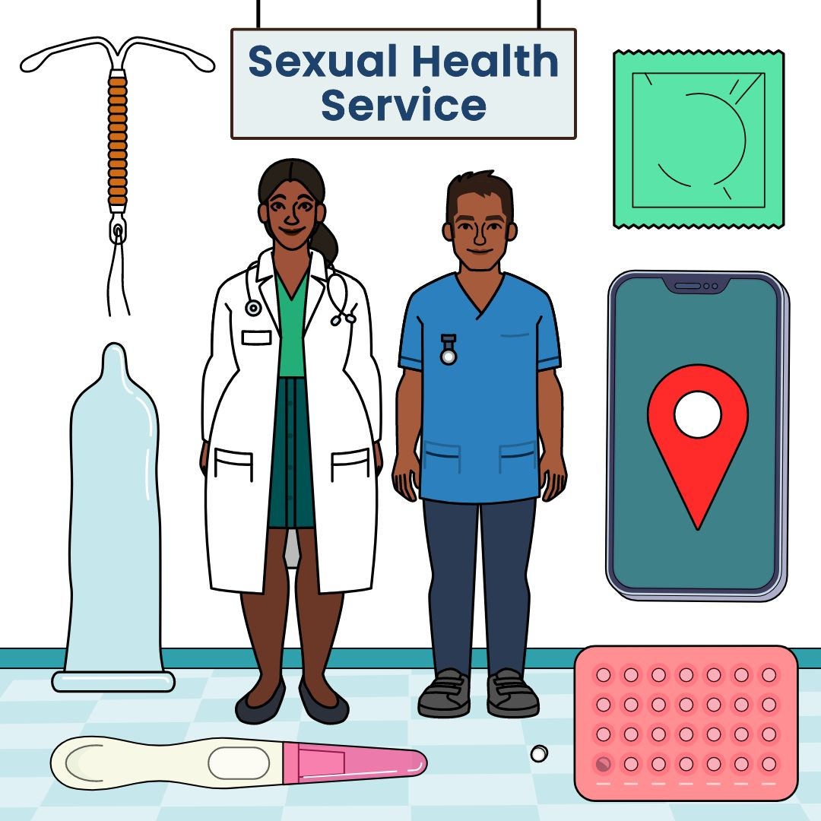
Young people aged 13 and older can get:
free condoms
pregnancy testing and advice
STI testing and treatment
emergency contraception
contraception (pill, implant, coil)
Notes:
Do not delete

Slide 5
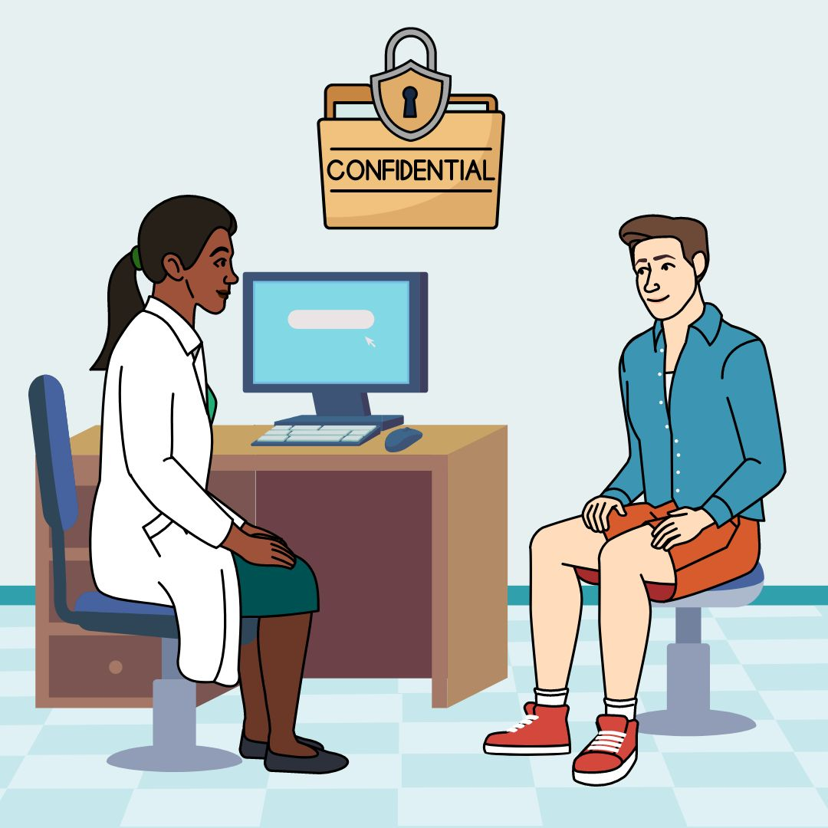
These services are confidential
This means the information you share with that service will stay private.
Notes:
Do not delete
Here are some examples of things that are confidential:
test results (for example tests for STIs)
your contraception choices
abortion or pregnancy choices

Slide 6
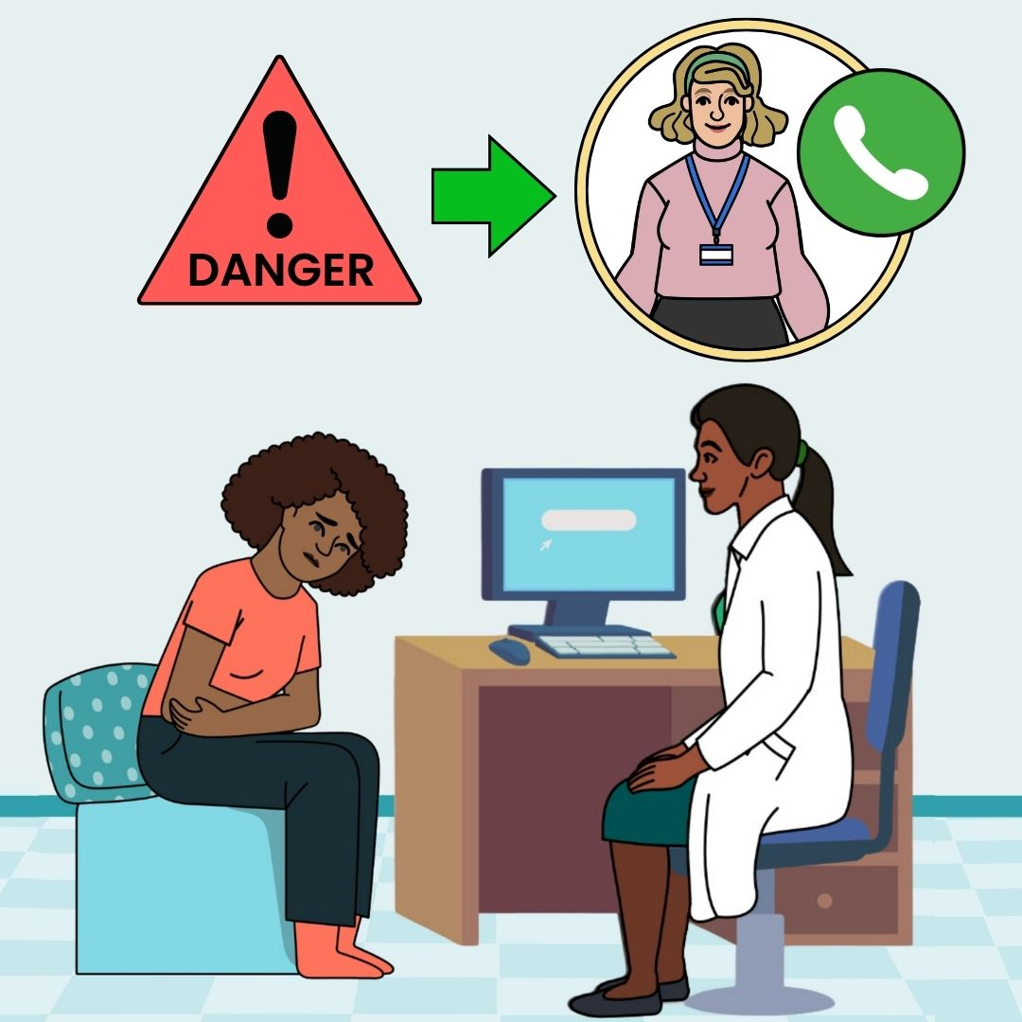
If the service thinks you are in danger or need further support, they may share some information with another professional to keep you safe.
Learn more about confidentiality
Notes:
Do not delete
Depending on the support or help you need, this could be another nurse, a doctor, a teacher or a youth worker.
The worker should let you know if they need to share information and who they will talk to.

Slide 7
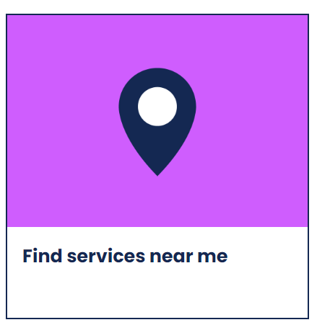
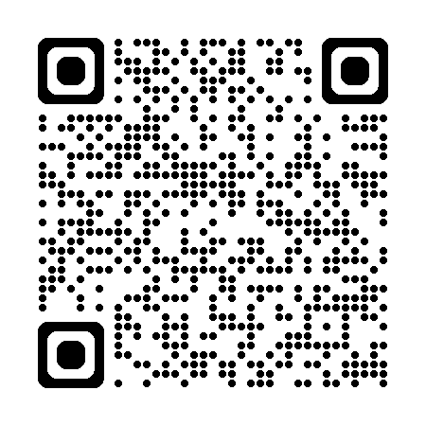
Where can young people find sexual health services?
Scan code or visit bit.ly/services-lothian
Notes:
Do not delete

Slide 8
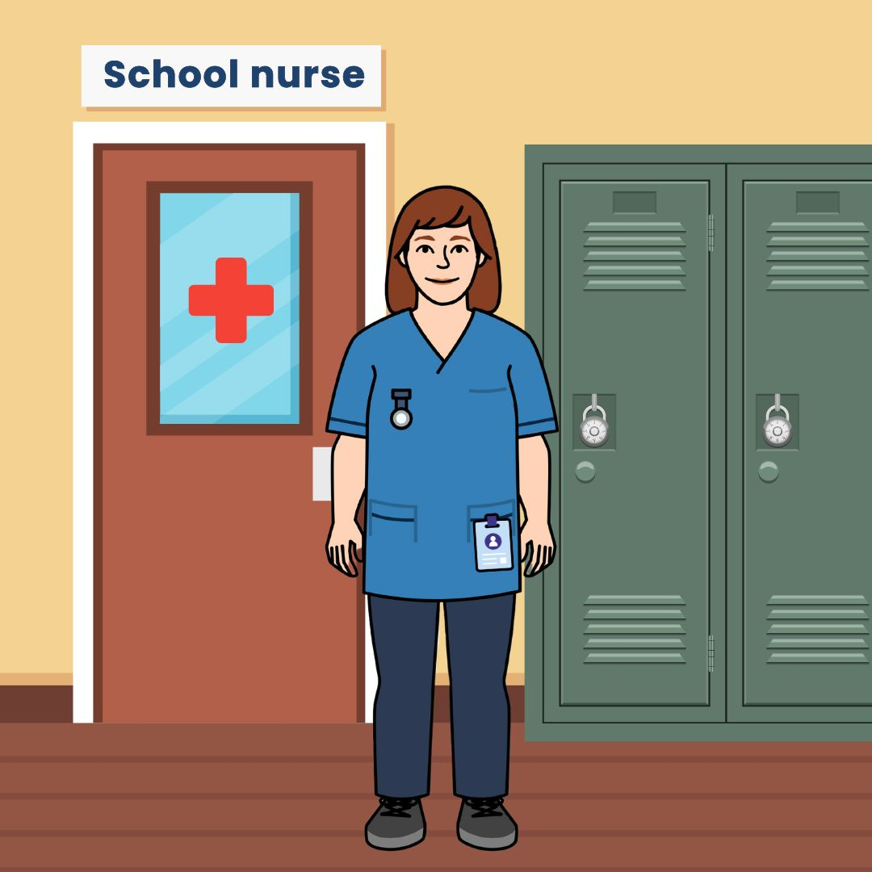

Talk to a school nurse
NHS Lothian school nurse in every school.
Get support, pregnancy testing and free condoms.
They offer the same confidentiality.
Ask your Pupil Support Leader about how to get an appointment.
Notes:
Do not delete
Find out if you have a school drop in here at https://www.healthyrespect.co.uk/find-services-near-me/

Slide 9
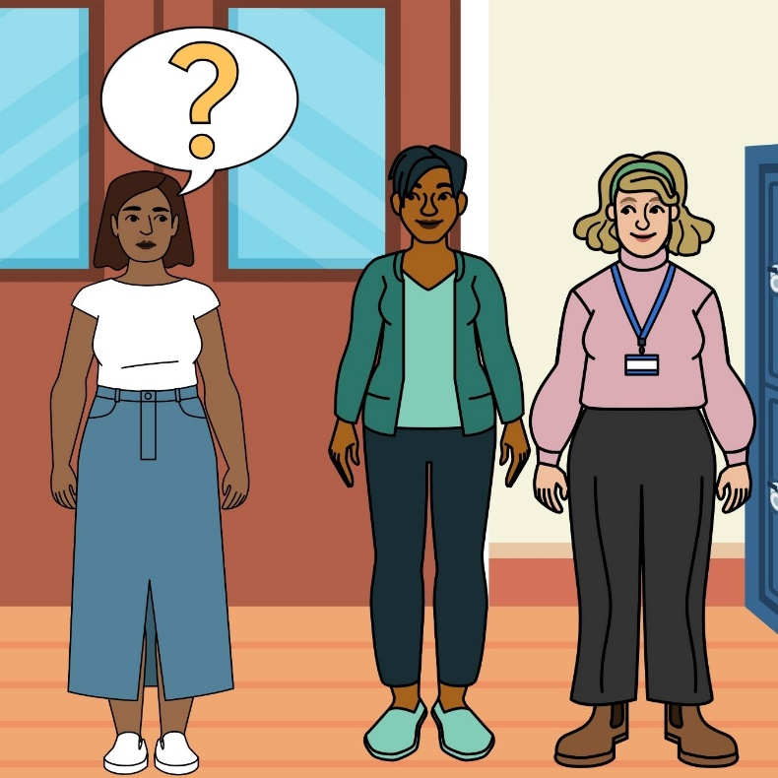
Talk to a youth worker at a Healthy Respect drop-in
Get support, pregnancy testing and free condoms.
For more information choose ‘Talk to a youth worker’ from services list on this page or scan code
Notes:
Do not delete

Slide 10


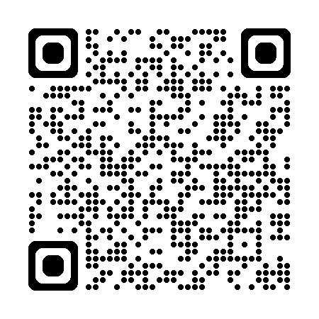
Get free condoms
at c:card points
by post.
Scan code or visit ccard.org.uk
Notes:
Do not delete – condoms by post come in a regular brown envelope and do not have any identifiable logos on them

Slide 11

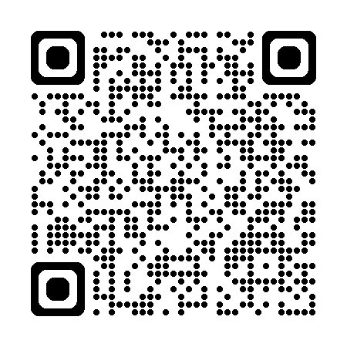
Get emergency contraception
Free from any pharmacy or Healthy Respect + clinic
Scan code or find more here
Notes:
Do not delete
Emergency contraception is medicine that can stop a pregnancy from happening after unprotected sex (penis in vagina sex).
You need to take emergency contraception as soon as possible after sex.
Emergency contraception can work if you take it within 5 days after having unprotected sex.
Young people aged 13 and older can access emergency contraception. You will need to give some details – Name, DOB, address, date of last period, when you had unprotected sex. This is a confidential service, the information will stay private unless there is worry you are in danger or you need further support, they may share some information with another professional to keep you safe.
Speak to a trusted adult to find out more about the best choice for you.

Slide 12

Healthy Respect + young people’s clinics in Lothian.
pregnancy testing and advice
STI testing and treatment
emergency contraception
contraception (pill, implant, coil)
Talk to a trusted adult –
  Youthworker, Nurse or Doctor
Notes:
Move down the slides to find out about each one.

Slide 13
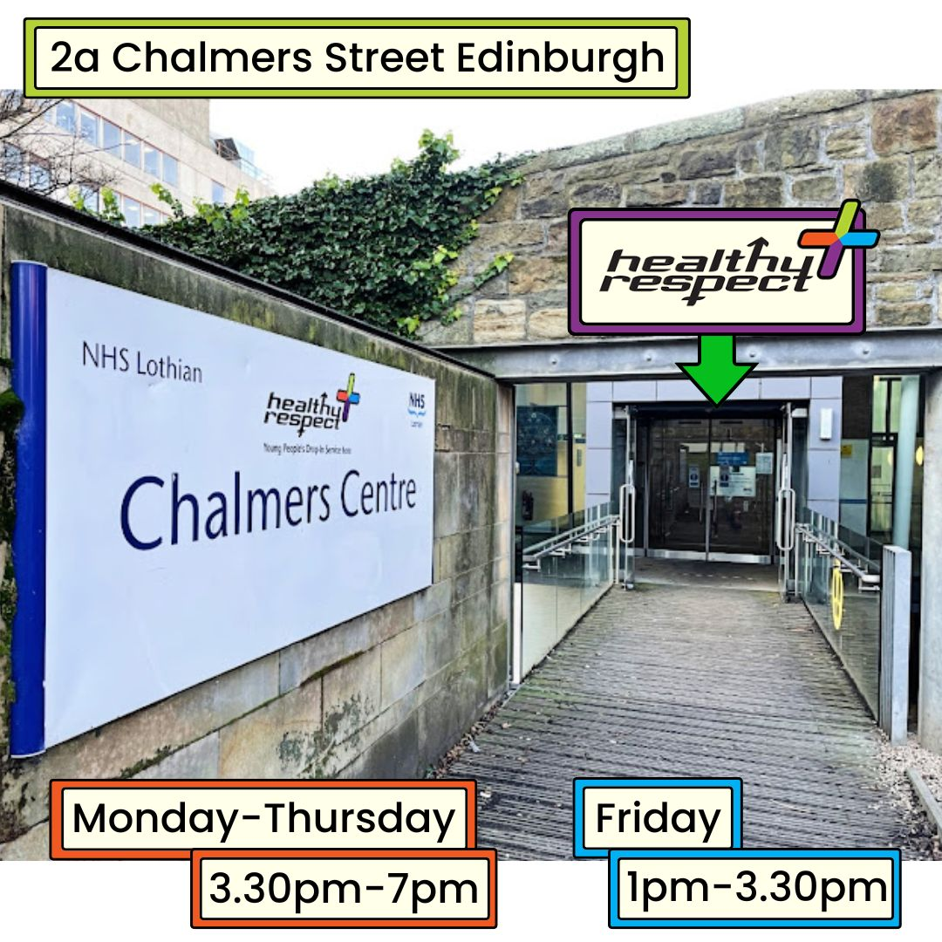
Edinburgh
Healthy Respect + young people’s clinic at Chalmers
For age 13-18
Monday to Thursdays
3:30pm to 7pm
Fridays 1pm – 3:30pm
There are no appointments, just come during the drop-in times.
Notes:
Do not delete
This clinic is for young people aged 13 to 18 years old
Staff are welcoming and there to support you

Slide 14
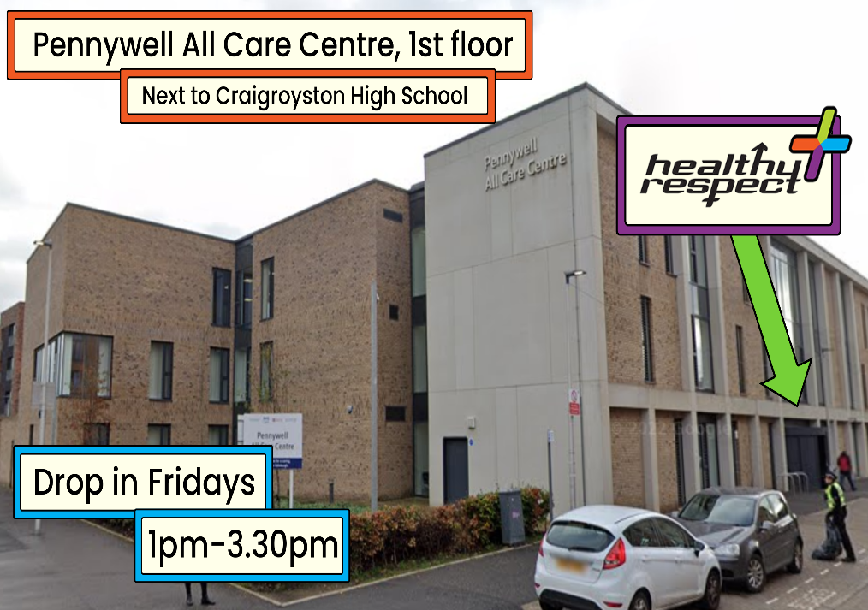
Edinburgh
Healthy Respect + young people’s clinic at Pennywell
For age 13+
Pennywell All Care Centre
Fridays 1pm – 3:30pm
There are no appointments, just come during the drop-in times.
Notes:
Delete if not relevant to your local authority
This clinic is for young people aged 13+
Staff are welcoming and there to support you

Slide 15
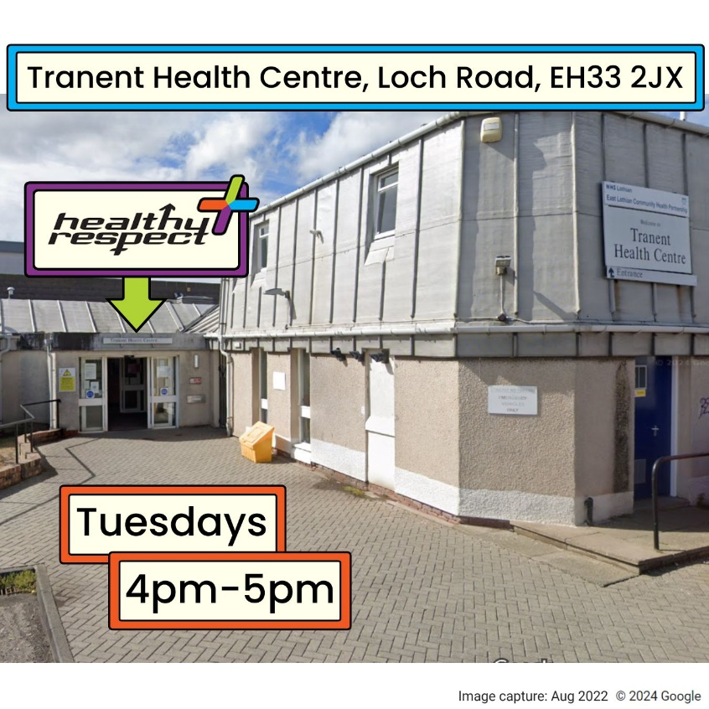
East Lothian
Healthy Respect + young people’s clinic at Tranent
For age 13+
Tranent Medical Practice
Tuesdays, 4:00pm to 5:00pm.
There are no appointments, just come during the drop-in times.
Notes:
Delete if not relevant to your local authority
This clinic is for young people aged 13+
Staff are welcoming and there to support you

Slide 16
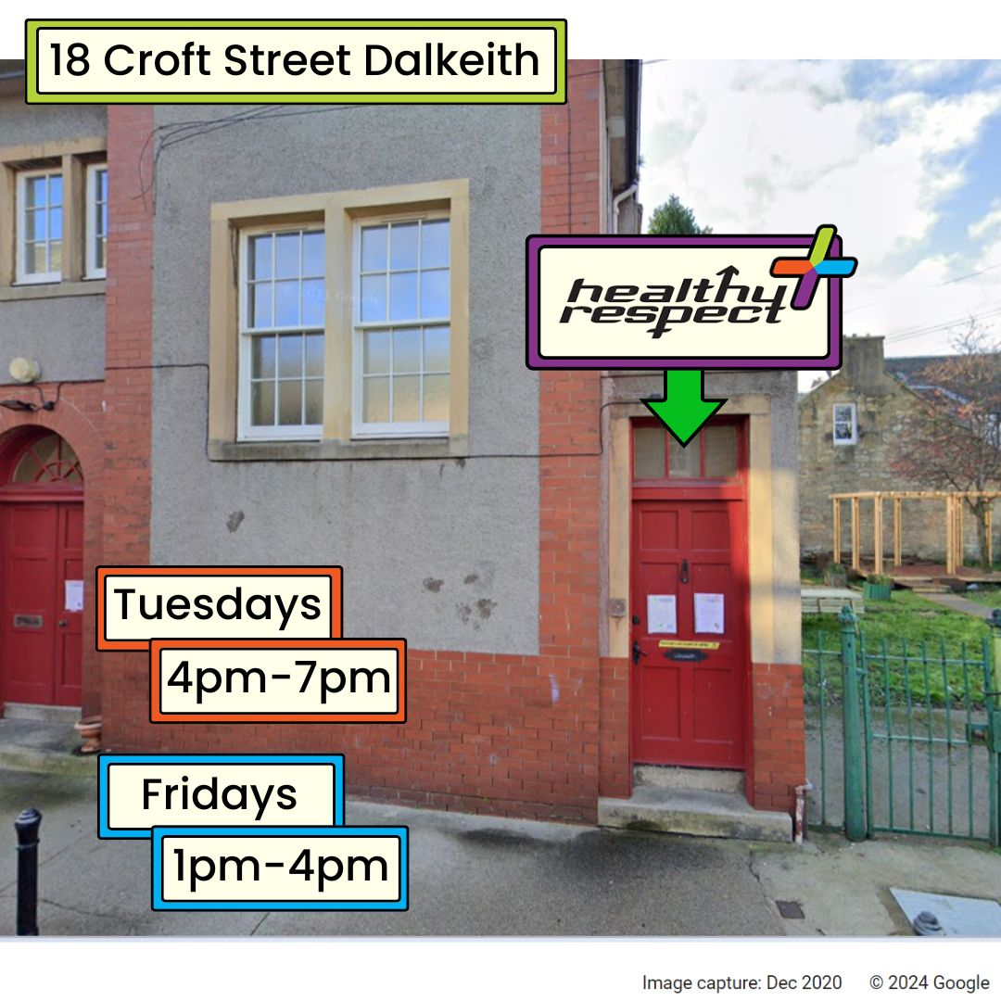
Midlothian
Healthy Respect + young people’s clinic at Croft St
For age 13+
Croft Street, Dalkeith
Tuesdays, 4pm – 7pm
Fridays, 1pm – 4pm
There are no appointments, just come during the drop-in times.
Notes:
Delete if not relevant to your local authority
This clinic is for young people aged 13+
Staff are welcoming and there to support you

Slide 17
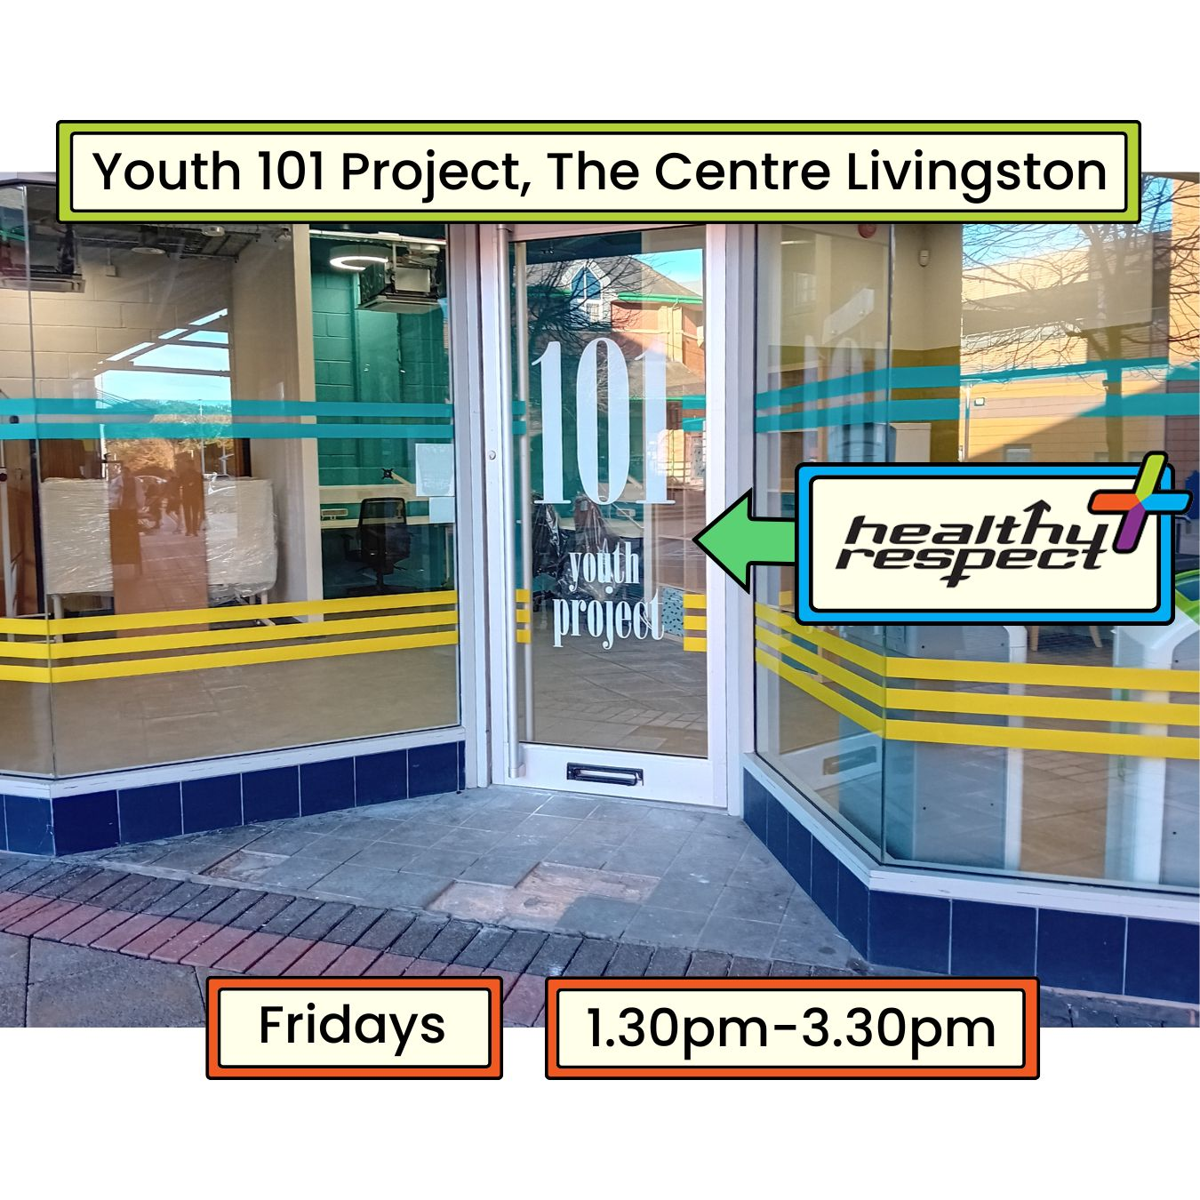
West Lothian
Healthy Respect + young people’s clinic at 101
For age 13+
101 Youth Project at
The Centre Livingston
Fridays, 1.30pm to 3.30pm
There are no appointments, just come during the drop-in times.
Find 101 It is just out past the exit doors at Costa, next door to kidzeco.
Notes:
Delete if not relevant to your local authority
This clinic is for young people aged 13+
Staff are welcoming and there to support you

Slide 18
Find services near me here
Scan code or visit bit.ly/services-lothian
Notes:
Do not delete

Slide 19
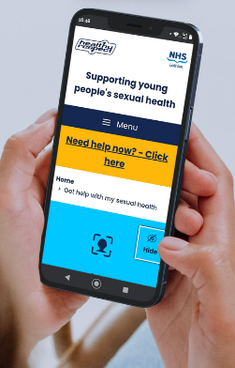
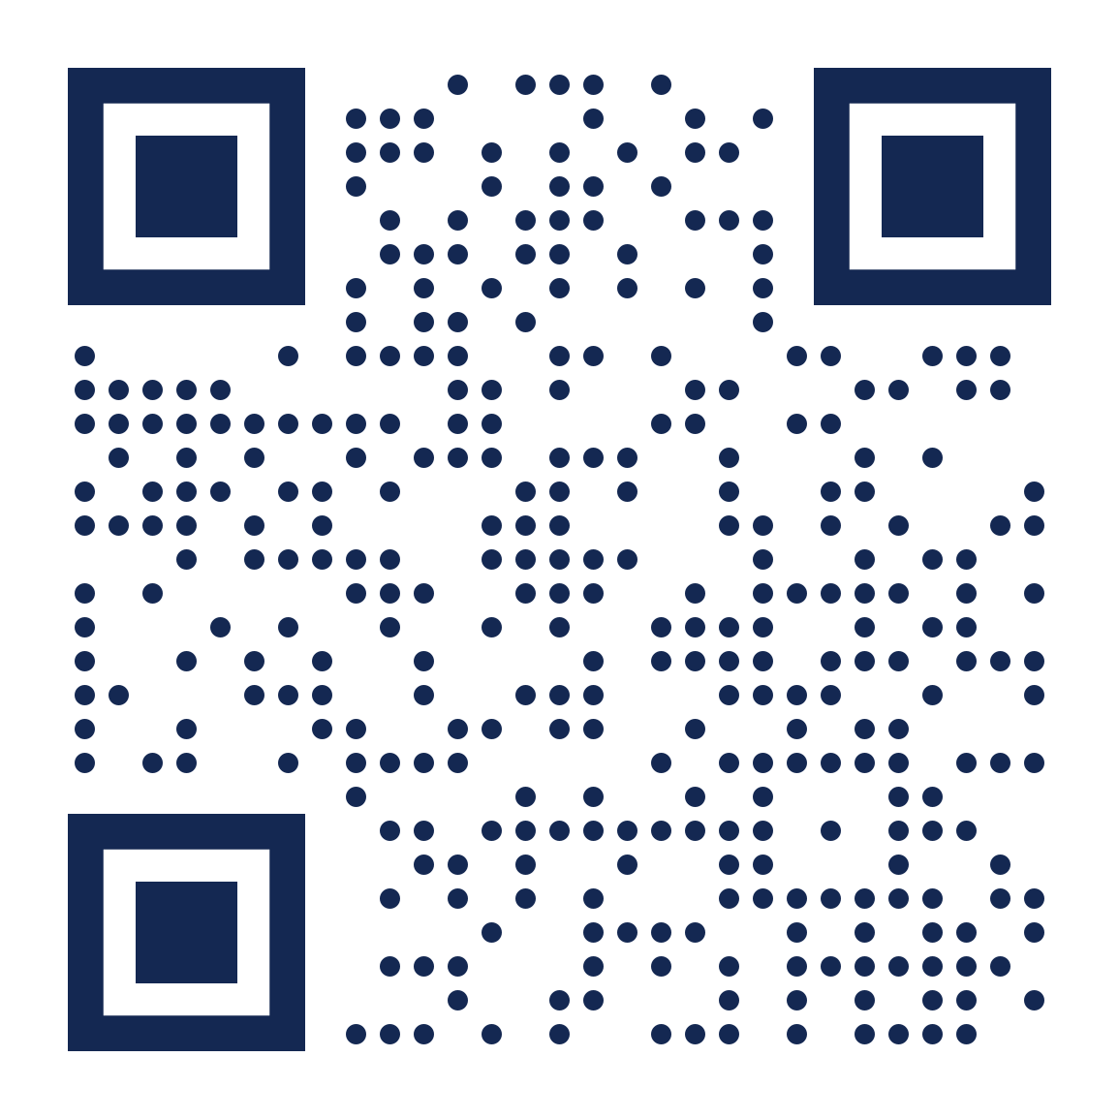
Want to know more about
sexual health and relationships?
Scan code or visit www.healthyrespect.co.uk
Notes:
Do not delete

